Slide 1
A Comparative Study on Convolution and Transformer based SOTA Object
Detection paradigms and models
Abhay Chowdhary, Parthiv Dholaria, Utsav Garg

Slide 2
Problem Statement
Object detection is a fundamental computer vision task that involves identifying and localizing objects within an image. This project aims to compare two state-of-the-art (SOTA) object detection paradigms:
Convolutional Neural Networks (CNNs) exemplified by EfficientDet
Transformers exemplified by DETR (DEtection TRansformer)
We will delve into their architectures, strengths, and weaknesses to understand how they approach the object detection challenge and their relative effectiveness

Slide 3
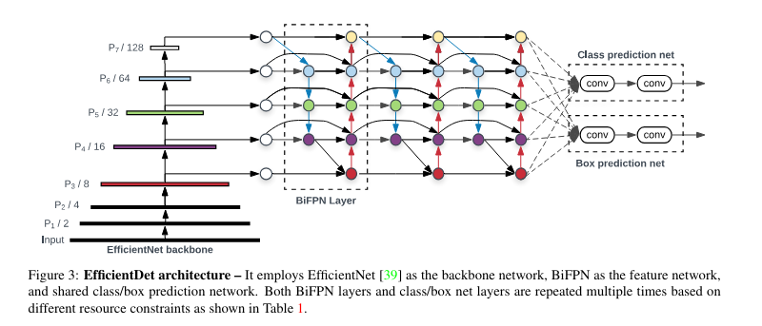
Efficient Det
EfficientDet is a high-performing object detection model based on convolutional neural networks (CNNs). It builds upon the success of Efficient Net, a family of CNN architectures designed for achieving high accuracy while maintaining the computational efficiency.
Scales all together: EfficientDet scales all parts of the model (size, depth) at once for efficient training and inference
Better features: BiFPN combines different levels of detail for richer feature extraction, improving object detection.
Handles imbalanced data: Focal loss tackles the challenge of uneven object categories in datasets, leading to better accuracy.
Top performance, less drag: EfficientDet delivers high accuracy while being faster than previous models, making it ideal for real-time use.

Slide 4
Efficient Det
The Backbone
Richer Features: Merges features from various network layers, combining high-level concepts with fine-grained details.
Two Pathways: Employs both bottom-up (low-level to high-level) and top-down (high-level to low-level) information flow.
Enhanced Context: This two-way flow improves the network's understanding of object context within the image.
Better Predictions: Leads to more accurate object detection by providing a more comprehensive feature representation.
Efficient Design: Designed to be lightweight and efficient, making it suitable for use within the EfficientDet model.
Compound Scaling
Similar to Efficient Net, EfficientDet utilizes a compound scaling approach to create a family of models with varying complexities. This family consists of several predefined EfficientDet models (e.g., EfficientDet-D0, EfficientDet-D7) that offer a trade-off between accuracy and computational efficiency. Users can choose the model that best suits their specific needs, depending on whether they prioritize higher accuracy or faster inference speed

Slide 5
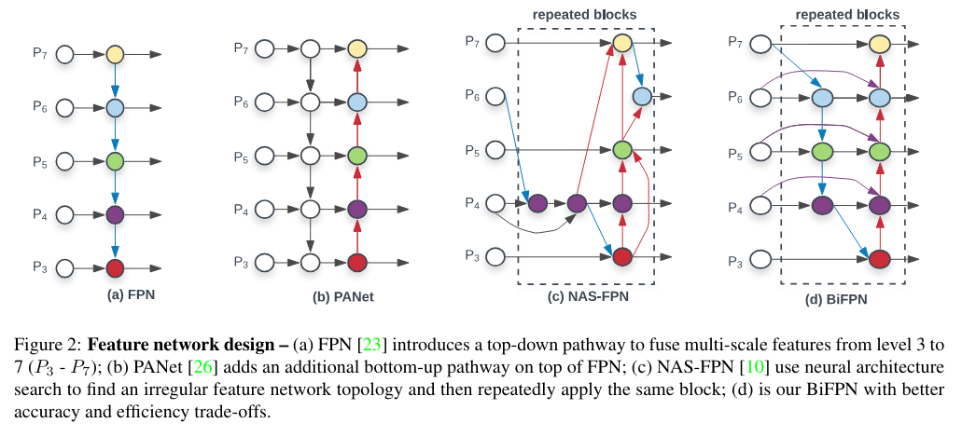
Efficient Det
Bi-directional Feature Pyramid Network (BiFPN)
Traditional object detection models often use a Feature Pyramid Network (FPN) to combine features from different network stages. However, FPN is limited in its ability to propagate high-resolution information from shallow layers to deeper layers. BiFPN addresses this limitation of by allowing for bi-directional information flow between different network stages. This enables EfficientDet to capture objects at various scales more effectively, resulting in improved detection accuracy for both small and large object.

Slide 6
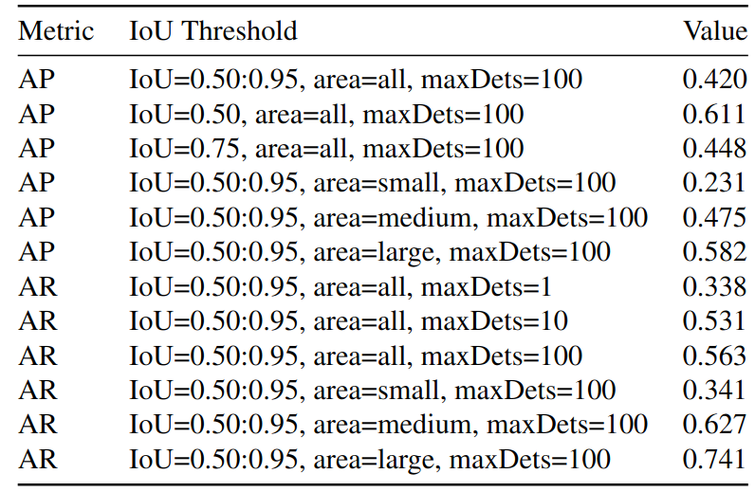
Inference Result of Efficient Det on COCO
While the official EfficientDet implementation by Google Research is in TensorFlow, we utilized a PyTorch adaptation [Sev20] for this work. This adaptation, as documented on the GitHub repository, removes unnecessary biases in convolutional layers followed by batch normalization, resulting in a slight reduction in model parameters.

Slide 7
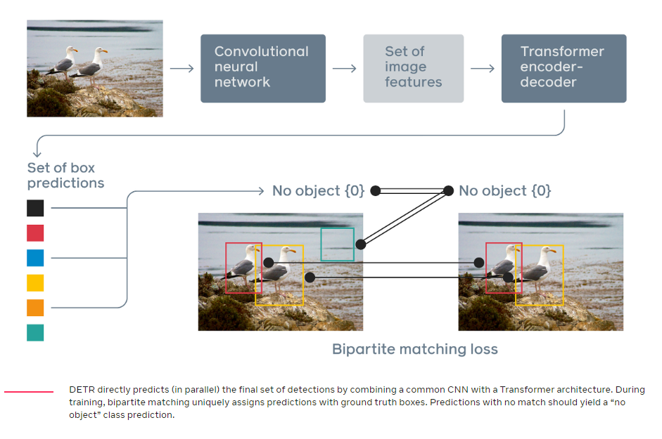
DETR
Object Detection with Transformers: DETR uses Transformers, known for natural language processing, for object detection in images.
CNN Backbone: It first utilizes a CNN to extract key features from the image.
Transformer Encoder-Decoder: Then, a Transformer encoder-decoder architecture analyzes the features and relationships between objects.
Set-based Prediction: Unlike traditional methods, DETR directly predicts a set of bounding boxes and object classes.
Unique Predictions: A special loss function ensures each prediction is unique and assigned to one object.
Source: https://ai.meta.com/blog/end-to-end-object-detection-with-transformers/

Slide 8
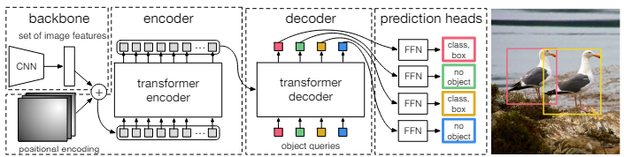
DETR: The Pipeline
Pre-trained Feature Extractor: The DETR model uses a pre-trained convolutional neural network (CNN) as the backbone feature extractor. This CNN efficiently captures informative features from the input image at a lower resolution.
Transformer Encoder: The CNN features are fed into the Transformer encoder. It uses self-attention to analyze relationships within the features.
Self-Attention: Self-attention lets each feature position attend to other positions, identifying informative regions and their connections.
Multi-Head Attention: Multiple attention heads are used in parallel, allowing the model to learn different aspects of the feature relationships.
Encoder Output: The encoder outputs a refined set of features capturing both object details and their spatial relationships.
Transformer Decoder: The decoder also uses self-attention but with a masking mechanism. This prevents the decoder from "cheating" by peeking at future outputs during prediction.
Decoder Prediction: The decoder predicts a set of queries, each containing a bounding box and a predicted class.

Slide 9
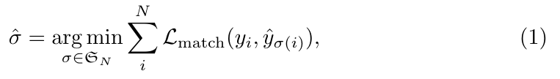

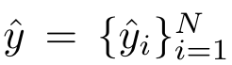
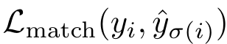

DETR: The Loss
Bipartite Matching: Unlike traditional detectors, DETR doesn't use Non-Maximum Suppression (NMS). Instead, it employs a technique called bipartite matching.
Two Sets: Bipartite matching works by considering two sets: one set containing the predicted bounding boxes and class labels, and the other containing the ground truth boxes and labels.
One-to-One Matching: The goal is to find the optimal one-to-one assignment between these sets.
Cost Function: A cost function (as shown in eqn 1.) is used to evaluate how well each predicted object "matches" each ground truth object.
Hungarian Algorithm: The Hungarian algorithm (as shown in eqn 2.), an efficient optimization method, finds the best possible assignment that minimizes the total cost across all matches. This ensures each prediction is assigned to a unique ground truth object during training.
Let us denote by y the ground truth set of objects, and ˆy = {yˆi} N the set of N predictions. Assuming N is larger than the number of objects in the image, we consider y also as a set of size N padded with ∅ (no object) and Lmatch(yi , y is a pairwise matching cost between ground truth yi and a prediction with index σ(i).

Slide 10
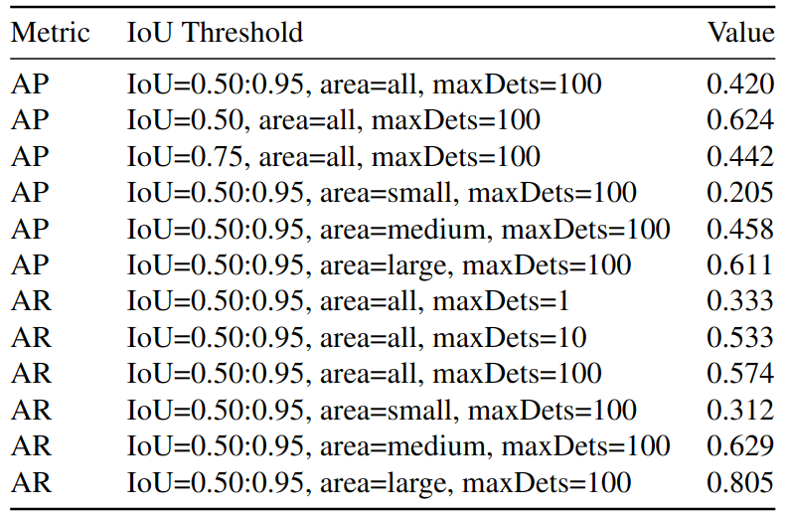
Inference Result of DETR on COCO
We successfully reproduced the exact results reported in the DETR paper ”End-to-End Object Detection with Transformers” by Nicolas Carion et al. (2020).

Slide 11
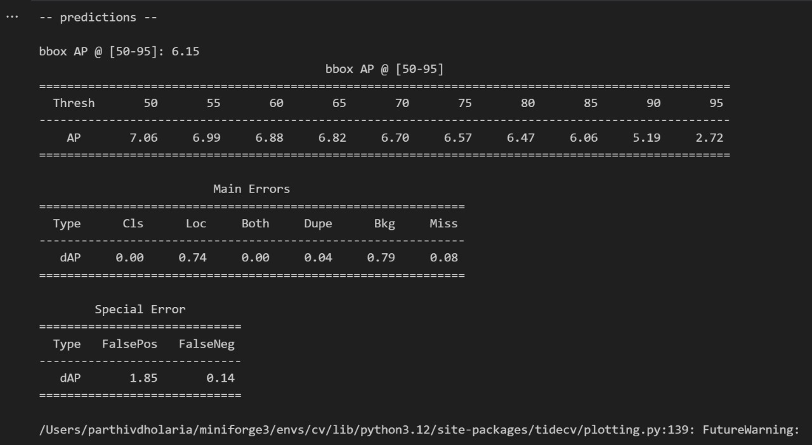
TIDE Analysis of Efficient Det on Pascal VOC 2012
To evaluate the performance of object detection models, researchers often rely on metrics that consider both the accuracy of the detections and the efficiency of the model. TIDE (Task-oriented Inference for Dense object Detection) is a metric that combines these two aspects. In the context of DETR and EfficientDet models, TIDE can be used to assess how well these models balance accuracy and efficiency for object detection tasks.

Slide 12
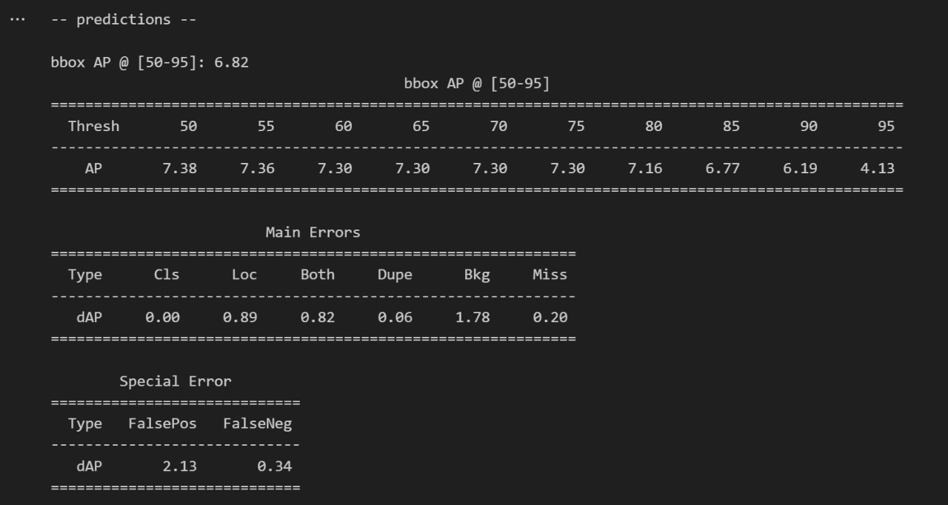
TIDE Analysis of DETR on Pascal VOC 2012
Overall, while DETR shows a slightly higher peak AP, its higher false positives and background errors might inflate its overall detection count, impacting efficiency. EfficientDet, with its lower false positives and background errors, might be a better choice for tasks where precision is crucial.

Slide 13
Qualitative and Quantitative Analysis
Calculated the IoU metrics for 20 images in the Pascal VOC dataset for the detection images by both models and results were as follows:
DETR: 0.87657
EfficientDet: 0.84210
We observed the following after an in depth analysis of the images comparison:
DETR surprisingly outperformed the EfficientDet model for small objects.
DETR showed abilities to use surrounding context for object detection.
EfficientDet had lower confidence scores even for correct predictions causing a lower threshold to miss detections, while DETR had extremely high scores even for wrong images causing detections which didn't exist.
DETR showed very good generalizability by identifying objects found in extremely different and unlikely environments
Observations made from the TIDE analysis
The COCO metric for evaluation (AP @ [50-95]) shows the better overall performance of DETR for the object detection task.
Although for the varying IoU thresholding EfficientDet shows consistent performance, while DETR average precision scores drops faster with higher thresholding.
DETR shows greater number of false positive (2.13) compared to EfficientDet (1.85), which suggest overall greater incorrect detections potentially impacting both accuracy and efficiency
Similarly, the EfficientDet performs slightly better in terms of background errors and missed detections.

Slide 14
Image Comparison And Analysis

Slide 15
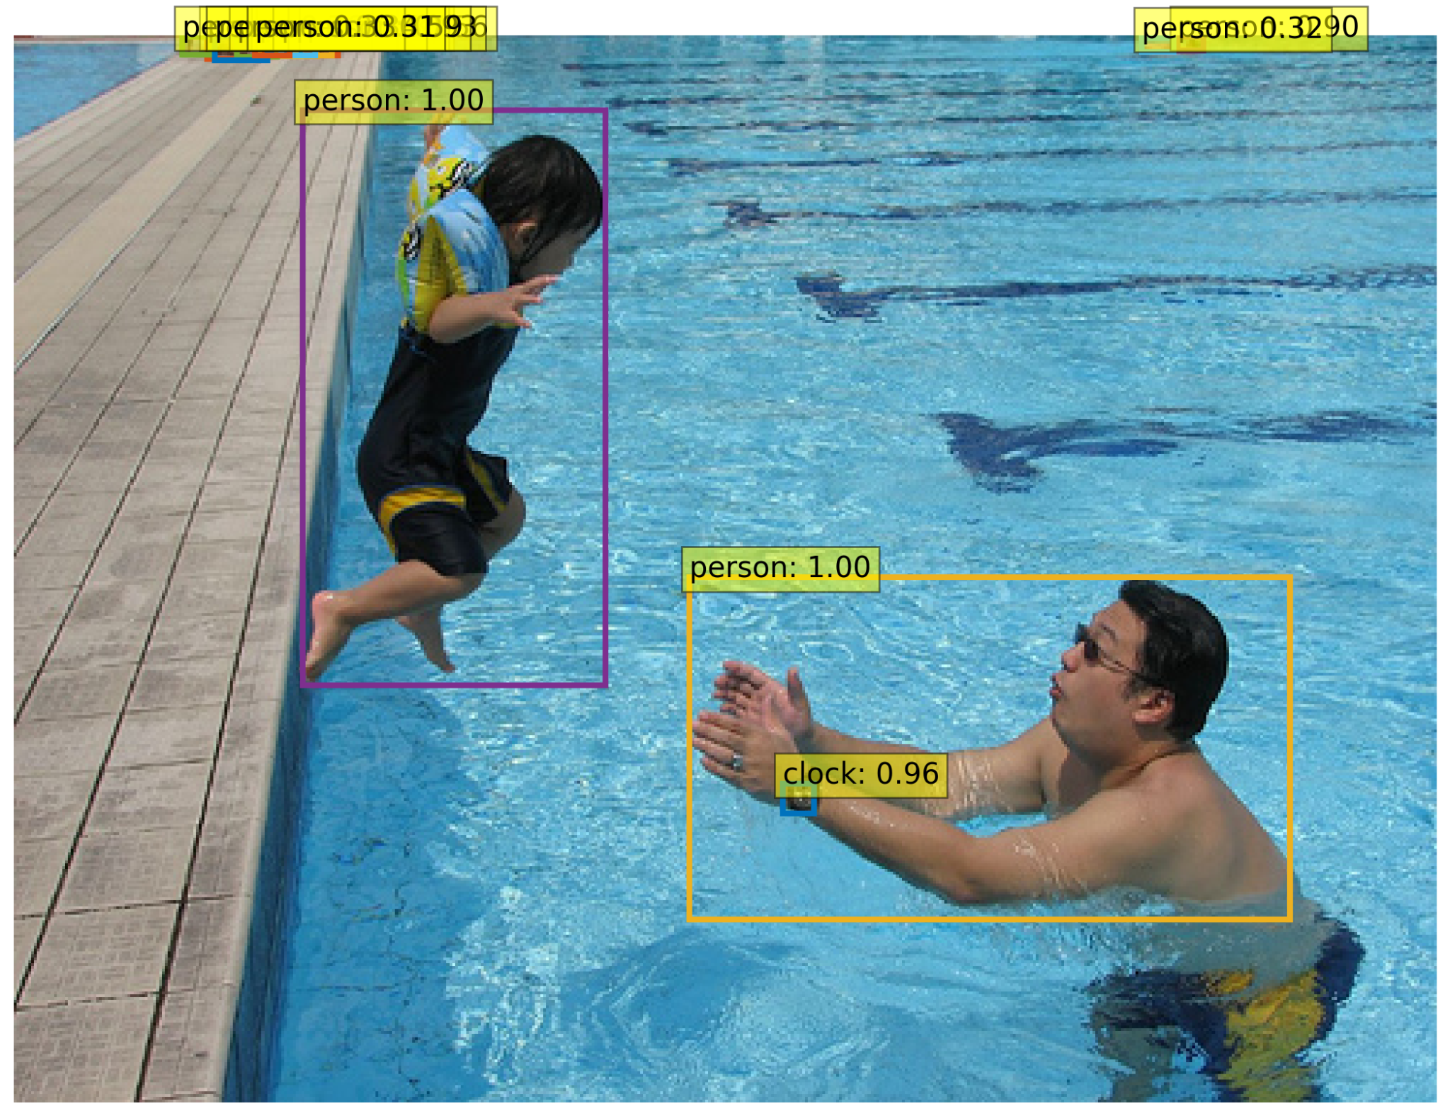
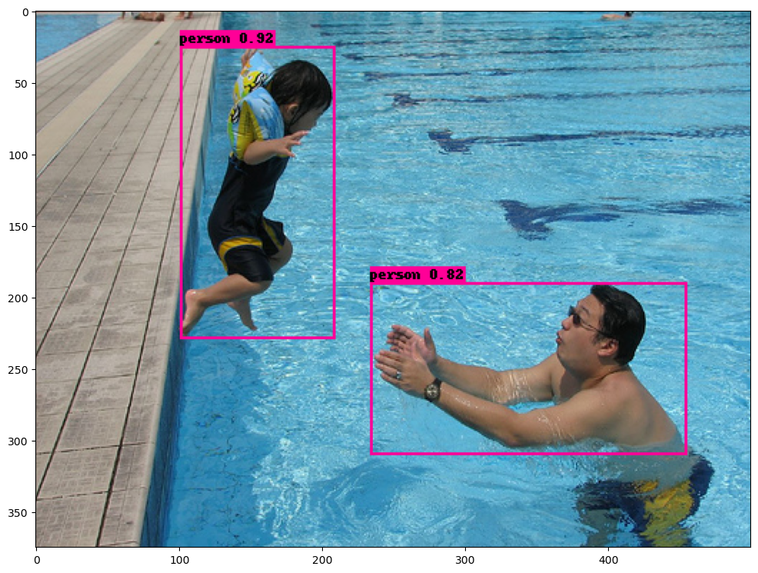
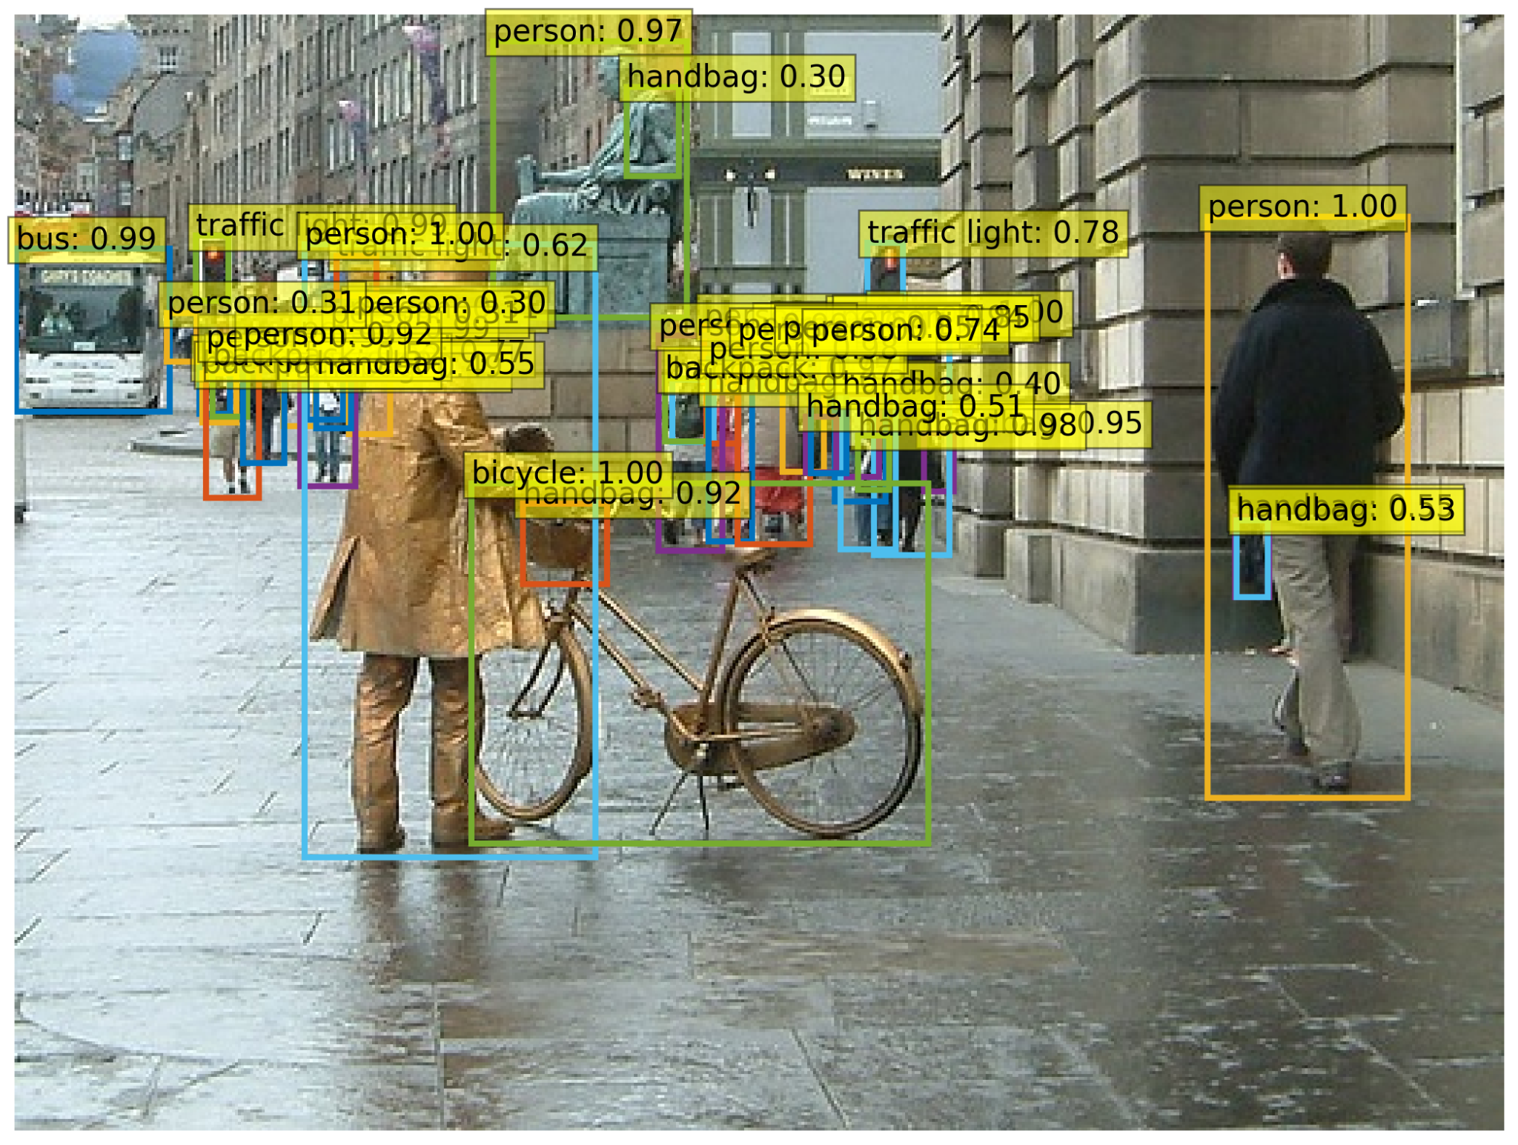
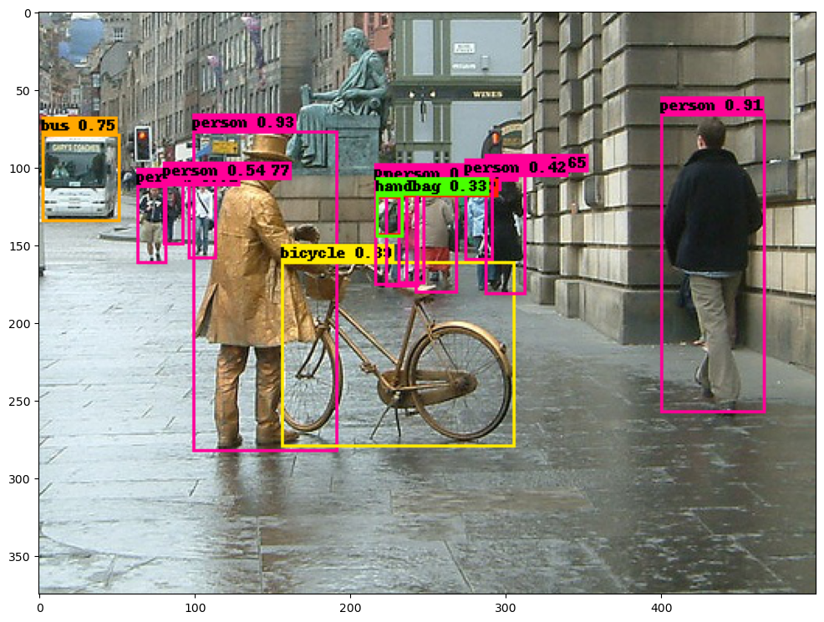
Small object detection
Despite the DETR paper suggesting lower performance on small objects, the presented results are surprising, it successfully identifying a small object (watch) classified as "clock" Outperforming EfficientDet. Also, DETR even detects partially visible people (lower probability) that EfficientDet misses entirely.
Here the DETR was able to recognize the small handbags while EfficientDet was not able to. Furthermore, DETR also recognized the traffic light which is also barely visible to the human eye.

Slide 16
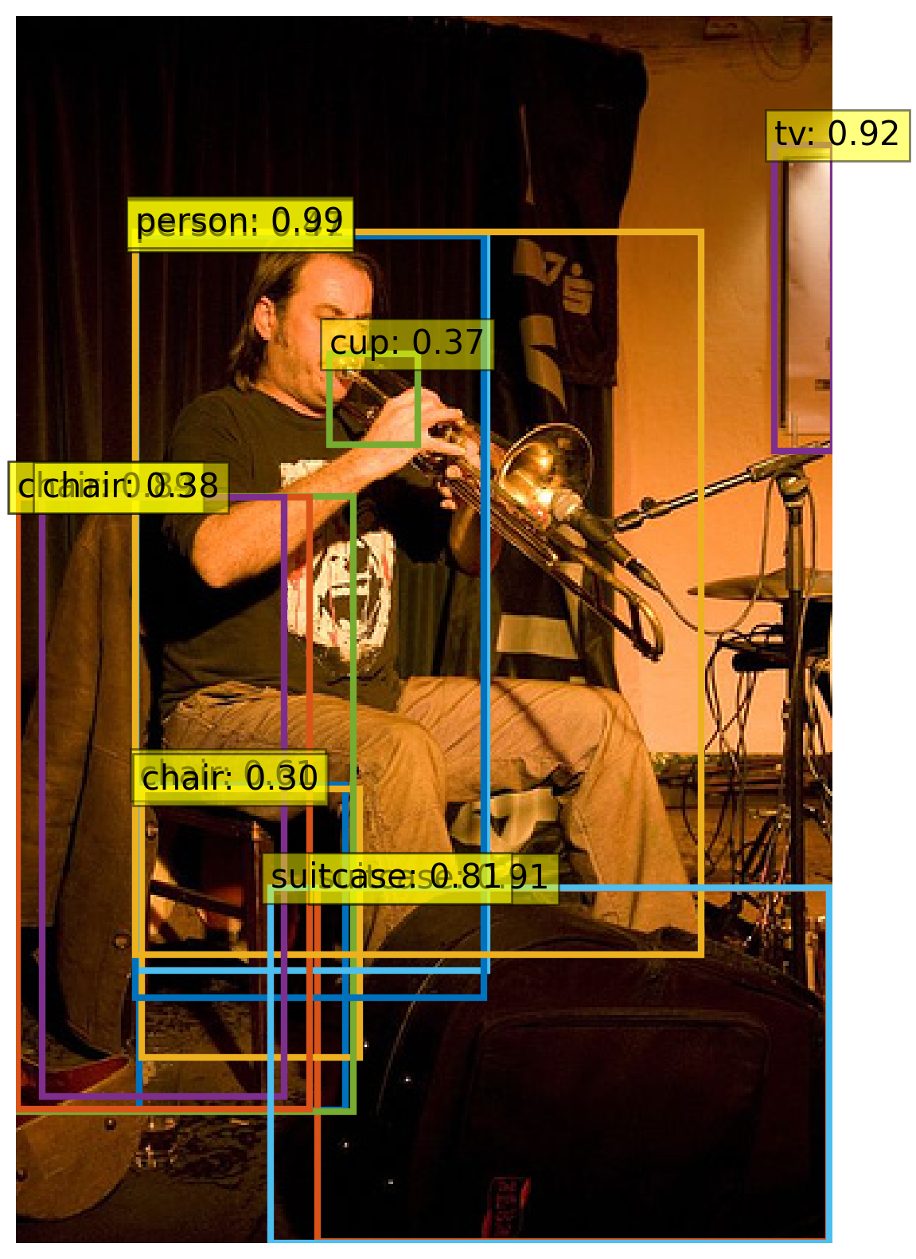
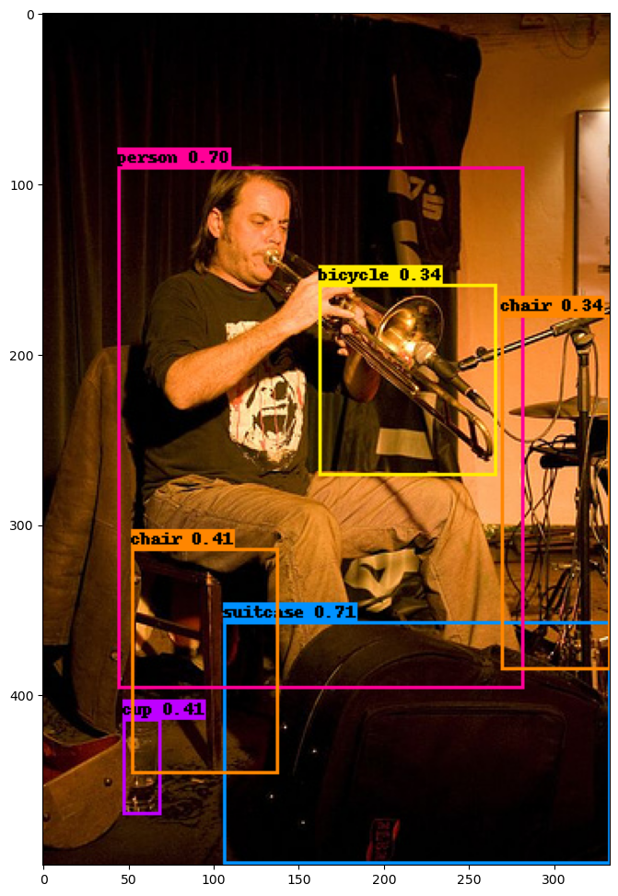
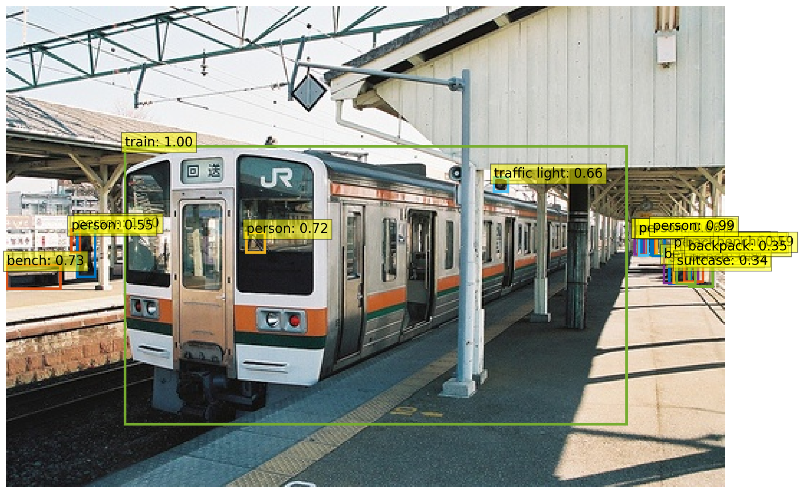
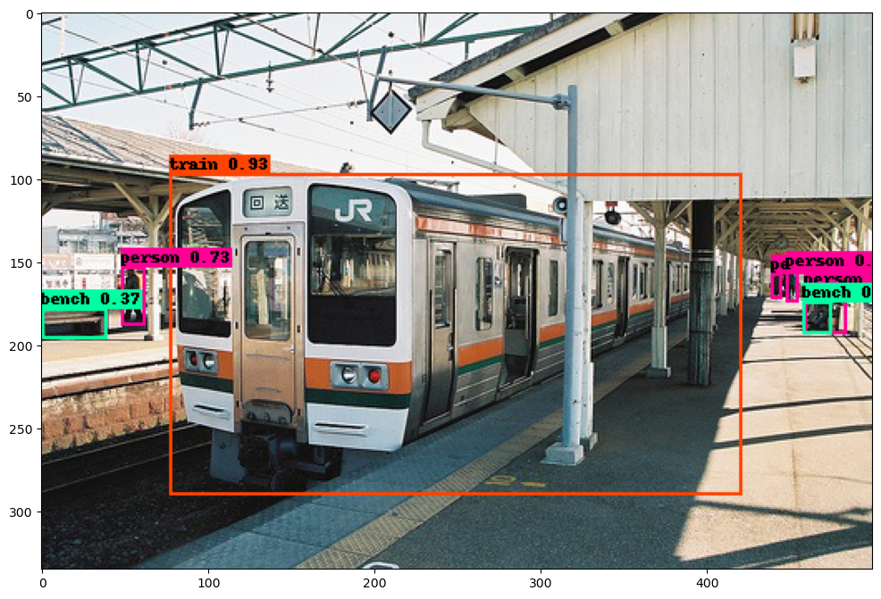
Context
DETR incorrectly identifies the trumpet as a cup, while EfficientDet avoids this mistake since DETR might use surrounding context for detection. The man's hand and trumpet position resemble cup contexts DETR has seen before. This suggests DETR learns not just object form but also surrounding cues (lower confidence implies uncertainty). Subsequently EfficientDet doesn't have a misidentified cup because there's no similar surrounding context for the cup compared to Fig 3. This implies DETR's attention mechanism might play a role in using contextual cues
DETR misclassified random unclear image patch inside train position as a person, possibly due to context of seeing person inside trains during training, again an indicator about the use of context for detention decision in DETR because of attention.

Slide 17
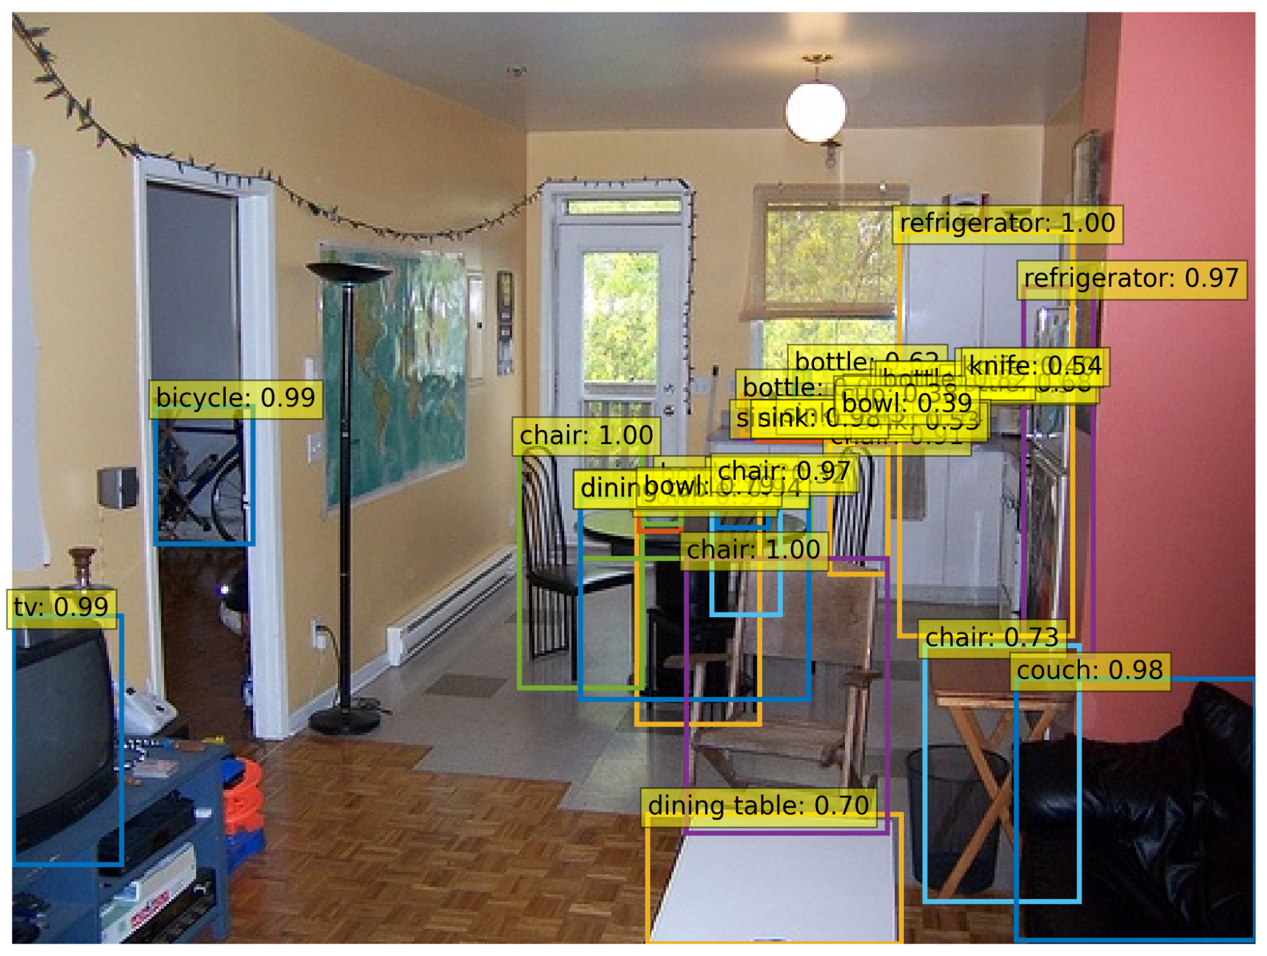
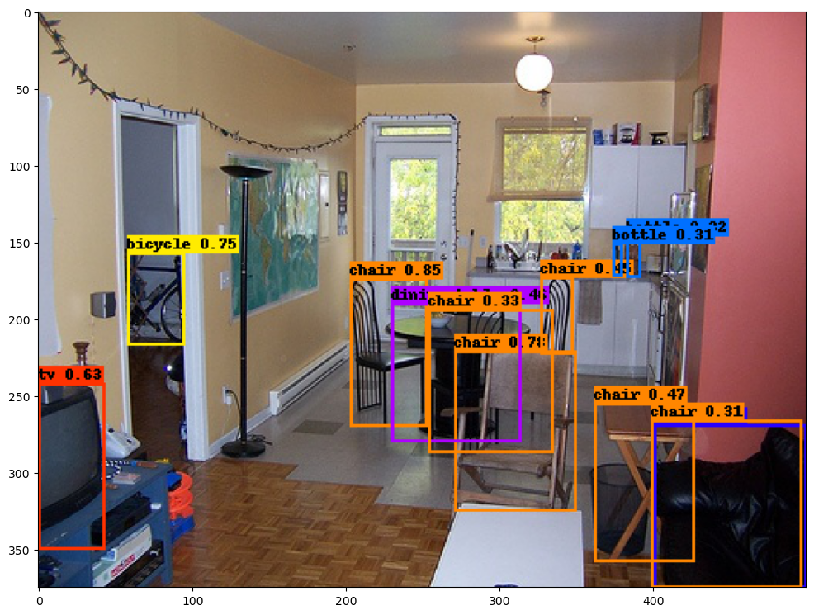
Confidence Disparity
Here we see that even for correct detection of objects, the DETR gives much higher confidence while EfficientDet has much lower average confidence such as (in living room images) bicycle in DETR is with probability 0.99 and in EfiicientDet is 0.72, TV in DETR is 0.99 and in EfficientDet is 0.63 despite both being correct in each case. This average skew causes issues while comparison with same thresholding causing DETR to detect objects not present and EfficientDet to barely miss multiple correct objects

Slide 18
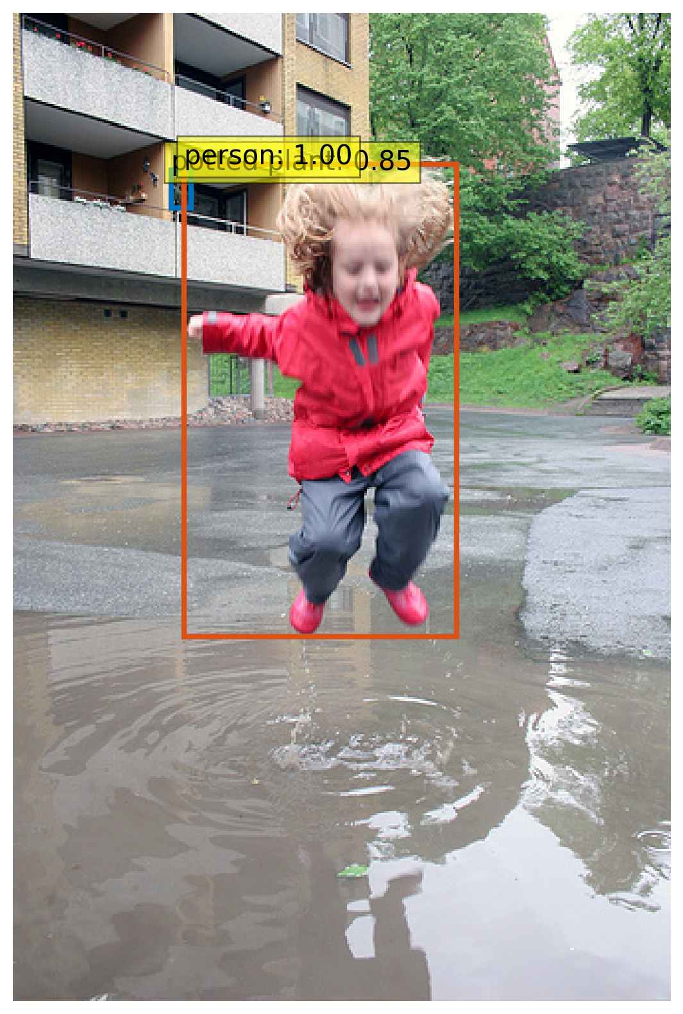
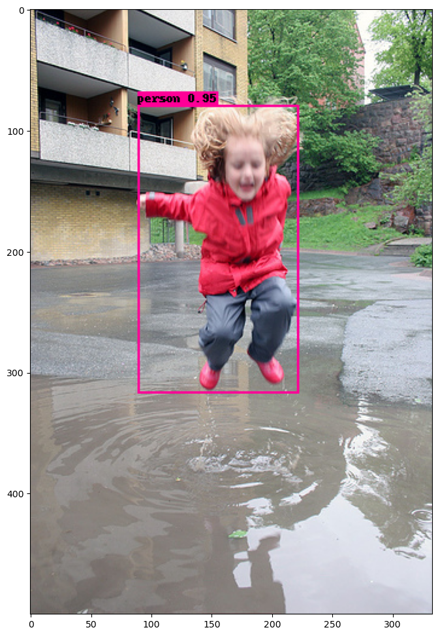
Generalizability
These show how clearly DETR better generalizes to un- seen environments and unlikely setups with its precise identification of the plant (depicted by the arrow) in the building which a human eye would have missed as well, while the efficientDet is unable to do the same.

Slide 19
Individual Contribution
Parthiv - EfficientDet inference on COCO, Testing on Pascal VOC 2012
Utsav - DETR inference on COCO, Testing on Pascal VOC 2012
Abhay - MIoU and TIDE analysis for both the models
We all three together made the slides and the report.

Slide 20
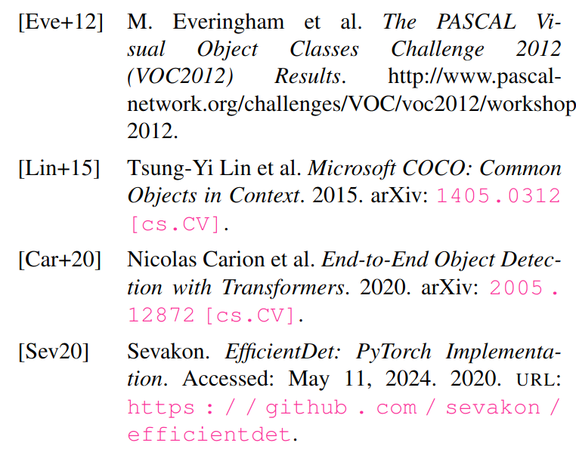
References

Slide 21
Thank You

